Slide 1


KS4 Mathematics
D6 Probabilities of Single events

Slide 2
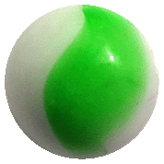
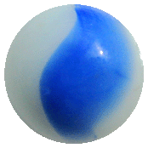
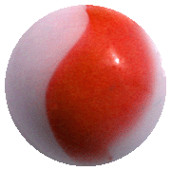
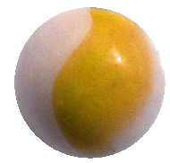

Calculating probability
If the outcomes of an event are equally likely then we can calculate the probability using the formula:
Number of successful outcomes
Probability of an event =
Total number of possible outcomes
For example, a bag contains 1 yellow, 3 green, 4 blue and 2 red marbles.
What is the probability of pulling a green marble from the bag without looking?
3
P(green) =
or 0.3
or 30%
10
Notes:
Point out that calculated probabilities are usually given as fractions but that they can also be given as decimals and (less often) as percentages.
Ask pupils to give you the probabilities (as decimals, fractions and percentages) of getting
A blue marble
A red marble
A yellow marble
A purple marble
A blue or a green marble etc.

Slide 3
Calculating probability
This spinner has 8 equal divisions:
What is the probability of the spinner
landing on a blue sector?
landing on a red or green sector?
not landing on a green sector?
1
a) P(blue) =
8
6
3
b) P(red or green) =
=
8
4
4
1
c) P(not green) =
=
8
2

Slide 4

Calculating probabilities
The probability of a spinner landing on yellow is 0.2.
What is the probability of not landing on yellow?
1 – 0.2 = 0.8
If the probability of an event occurring is p then the probability of it not occurring is 1 – p.
A spinner has green, red and blue sections. Landing on red is twice as likely as landing on green. Fill in the missing probabilities:
Green
Red
Blue
0.26
0.52
0.22

